Slide 1


Mattis K
2024-03-08

Slide 2

Outline
Executive Summary
Introduction
Methodology
Results
Conclusion
Appendix

Slide 3
Executive Summary
Summary of methodologies
Summary of all results

Slide 4
Project background
SpaceX advertises Falcon 9 rocket launches on its website, with a cost of 62 mUSD; other providers of the same services could charge a cost of upwards of 165 mUSD each. The differences in cost is primarily due to SpaceX being able to reuse the first stage of their rockets. Therefore, if one can determine if the first stage will land successfully and thus be reused, one can determine the cost and savings of a launch.
The predictions made in this project can be used if an alternate company wants to bid against SpaceX for a rocket launch
Problems you want to find answers
Which factors contributes towards predicting whether the first stage of the rocket will land successfully?
The interaction between the factors to determine the success rate of a successful landing of the first stage of the rocket.
What conditions that needs to be in place to secure a successful landing and provide alternate bidders with intelligence of when and how to launch their rockets in order to successfully recover and reuse the first stage of their rockets.
Introduction

Slide 5

Section 1

Slide 6
Methodology
Executive Summary
Data collection methodology:
Data has been collected using the SpaceX API (Open data) and using web scraping on SpaceX data from Wikipedia.
Perform data wrangling
Missing data has been handled by calculating the means for the continuous variables in the dataset and replacing the missing values with the calculated mean.
In order to fit categorical variables to our predictive models, One-hot encoding was applied to all categorical features.
Perform exploratory data analysis (EDA) using visualization and SQL
Perform interactive visual analytics using Folium and Plotly Dash
Perform predictive analysis using classification models
How to build, tune, evaluate classification models

Slide 7
API and Web scraping
The base data used in this project stem from the SpaceX REST API (https//.docs.spacexdata.com)
Specifically, the /launches/past endpoint was used to collect information about SpaceX’s past launches and collect information on whether the landing of the first stage rocket was successful or not to train the models used to predict optimal conditions to launch an alternate rocket in.
Data from the API required some cleaning, checking for missing values filling these missing values where necessary using the mean for continuous variables collected from the API response.
The base data was supplemented with scraped data from Wikipedia’s page about the Falcon 9 rocket launches.
The data was residing in a HTML table and which was scraped using Python’s web scraping library “BeautifulSoup”.
Data Collection

Slide 8
Data Collection – SpaceX API
Using Python’s Requests library and Get method we accessed the /launches/past endpoint from the SpaceX REST API.
Using the REST API JSON response we then normalized and flattened the data into a Pandas dataframe making it ready for further processing.
GitHub Notebook: dscap/data_collection_api.ipynb at main · mattan87/dscap (github.com)
Requesting Launch Data from SpaceX REST API
Decoding of response content using .json() and turning API response to datafram .json_normalize()
Requesting needed information about launches from SPACEX API through custom functions
Flattening the data into a Pandas dataframe
Filtering the dataframe for Falcon 9 data only
Replacing missing Payload Mass values using calculated .mean() from the same column
Exporting the data to CSV
8

Slide 9
Data Collection - Scraping
Using Python’s Requests library and Get method we accessed the /launches/past endpoint from the SpaceX REST API.
Using the REST API JSON response we then normalized and flattened the data into a Pandas dataframe making it ready for further processing.
GitHub Notebook: dscap/data_collection_api.ipynb at main · mattan87/dscap (github.com)
Requesting Launch Data from SpaceX REST API
Decoding of response content using .json() and turning API response to datafram .json_normalize()
Requesting needed information about launches from SPACEX API through custom functions
Flattening the data into a Pandas dataframe
Filtering the dataframe for Falcon 9 data only
Replacing missing Payload Mass values using calculated .mean() from the same column
Exporting the data to CSV
9

Slide 10

Data Wrangling
First step of the process was to identify whether the collected data contained null values to understand whether we had gaps in the data that needed to be handled prior to fitting any model
Secondly, we analyzed the whether the data was categorical or numerical to understand whether we had to standardize the data
Third, we explored the occurrences of the different cateogircal variables, such as
Landing Outcomes (How the First Rocket Stages landed)
Four, based on the third step we classified whether a landing outcome was a success or a fail to be able to get a label on which we could train and also test our models and their respective algorithms.
dscap/eda-dataviz.ipynb at main · mattan87/dscap (github.com)

Slide 11
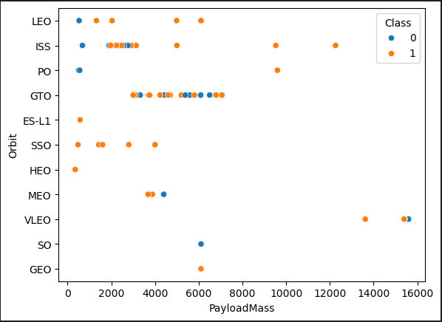
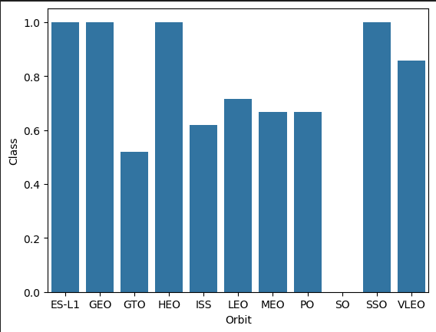
EDA with Data Visualization
Data was explored by visualizing the relationship between flight number and launch site, payload and launch site, success rate of each orbit type etc.
dscap/eda-dataviz.ipynb at main · mattan87/dscap (github.com)

Slide 12
SQL Queries to Support Explorative Data Analysis:
Display the names of each unique launch site
Display 5 records with launch site name starting with ‘CCA’
Display total payload mass carried by all boosters launched by NASA (CRS)
Displaying average payload mass carried by booster version F9 v1.1
Listing the date when the first successful landing outcome on a ground pad landing platform was performed
Listing the names of boosters that successfully landed on a drone ship with a pay load mass between 4000 and 6000 kg
Listing the total number different mission outcomes
Listing the names of booster versions that have carried the maximum payload mass
Listing the failed landing outcomes on a drone ship for the months in 2015 including
Booster version
Launch site names
Creating a rank based on the count of landing outcomes between 2010-06-04 and 2017-03-20 (Descending order)
No landing attempt was the most frequent occurring outcome with 21 counts and Precluded (drone ship) was the least occurring with 1 count
dscap/eda-sql-coursera_sqllite.ipynb at main · mattan87/dscap (github.com)
EDA with SQL

Slide 13
We marked all launch sites, and added map objects such as markers, circles, lines to mark the success or failure of launches for each site on the folium map.
We assigned the feature launch outcomes (failure or success) to class 0 and 1.i.e., 0 for failure, and 1 for success.
Using the color-labeled marker clusters, we identified which launch sites have relatively high success rate.
We calculated the distances between a launch site to its proximities. We answered some question for instance:
Are launch sites near railways, highways and coastlines. Which they were given there is a need to transport larger object to rockets as well as fuel for the rockets.
Do launch sites keep certain distance away from cities. Which they do, since the nature of a launch is quite dangerous to do in close proximity to an inhabited area should something go wrong.
dscap/launch_site_location.jupyterlite.ipynb at main · mattan87/dscap (github.com)
Build an Interactive Map with Folium

Slide 14
We built an interactive dashboard with Plotly dash
We plotted pie charts showing the total launches by a certain sites
We plotted scatter graph showing the relationship with Outcome and Payload Mass (Kg) for the different booster version.
Notebook with application: dscap/spacex_dash_app.py at main · mattan87/dscap (github.com)
Build a Dashboard with Plotly Dash

Slide 15
We loaded the data using numpy and pandas, transformed the data, split our data into training and testing.
We built different machine learning models and tune different hyperparameters using GridSearchCV.
We used accuracy as the metric for our model, improved the model using feature engineering and algorithm tuning.
We found the best performing classification model.
dscap/SpaceX_Machine_Learning_Prediction.ipynb at main · mattan87/dscap (github.com)
Predictive Analysis (Classification)

Slide 16
Exploratory data analysis results
Interactive analytics demo in screenshots
Predictive analysis results
Results

Slide 17

Section 2

Slide 18
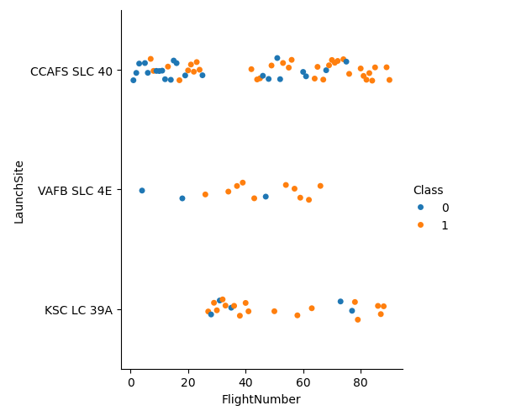
Flight Number vs. Launch Site
From the plot, we found that the greater the flight number at a lunch site the more likely it would be a success
Given a later flight number one can assume that learnings has been incorporated in to later flights which would also contribute towards more successful launches

Slide 19
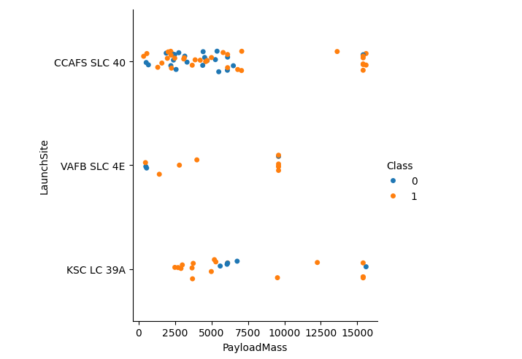
Payload vs. Launch Site
The greater the payload mass for CCAFS SLC 40 the more likely it is a success.

Slide 20
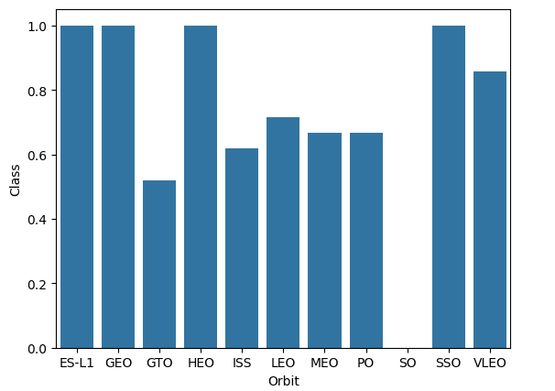
Success Rate vs. Orbit Type
From the chart, ES-L1, GEO, HEO, SSO, VLEO are the orbit types with the greatest success rates.

Slide 21
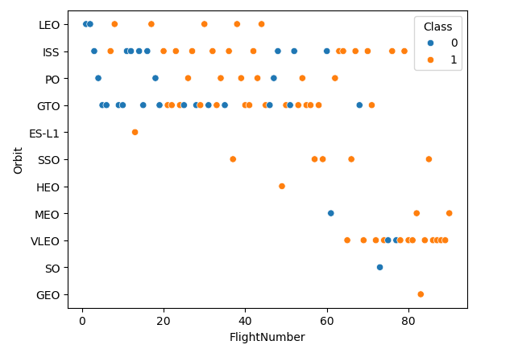
Flight Number vs. Orbit Type
The plot below shows the Flight Number vs. Orbit type. We observe that in the LEO orbit, success is related to the number of flights whereas in the GTO orbit, there is no relationship between flight number and the orbit.

Slide 22
Payload vs. Orbit Type
We can observe that with heavy payloads, the successful landing are more for PO, LEO and ISS orbits.

Slide 23
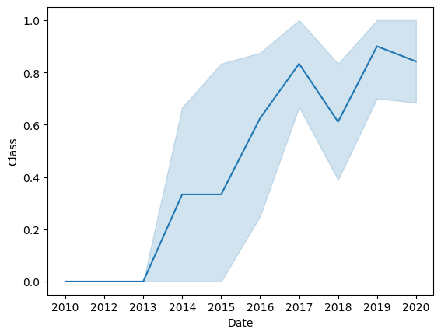
Launch Success Yearly Trend
From the plot, we can observe that success rate since 2013 kept on increasing till 2020.
Launces from 2010 up until the end of 2012 were unsuccessful.

Slide 24
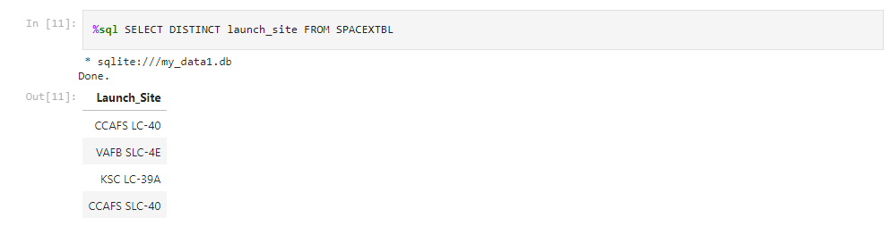
All Launch Site Names
We used the key word DISTINCT function to show the unique launch sites from the SpaceX data.

Slide 25
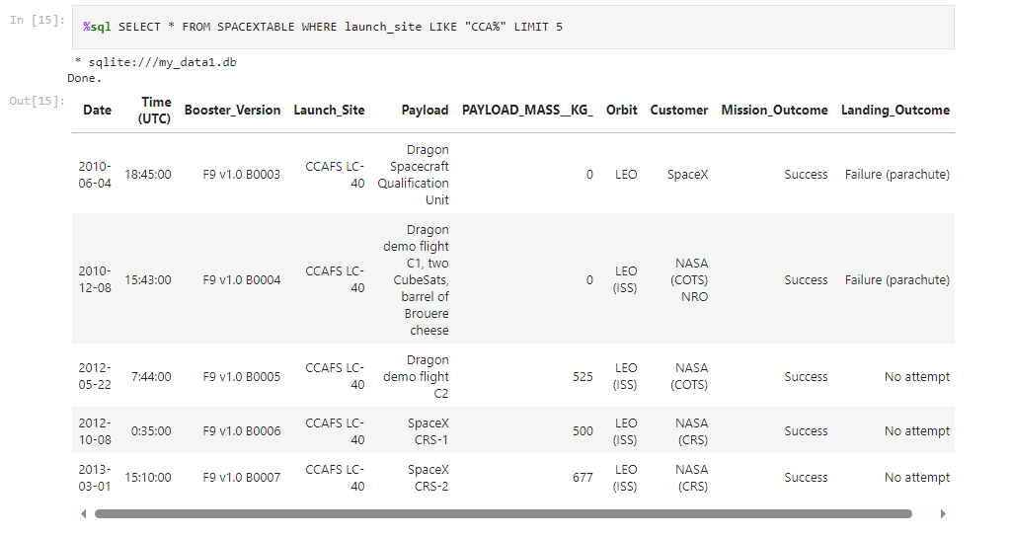
Launch Site Names Begin with 'CCA'
We used the query below to display 5 records where launch sites begin with `CCA`

Slide 26
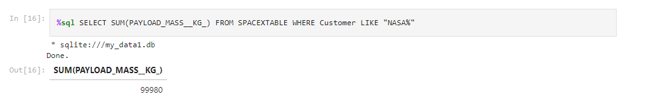
Total Payload Mass
We calculated the total payload carried by boosters from NASA as 99980 kg using the query below

Slide 27
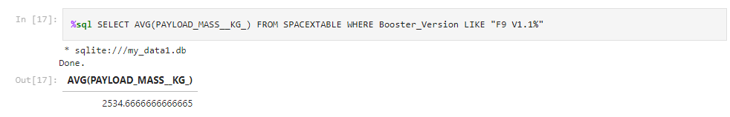
Average Payload Mass by F9 v1.1
The average payload mass for booster version F9 V1.1 was calculated to 2534.6 kg

Slide 28
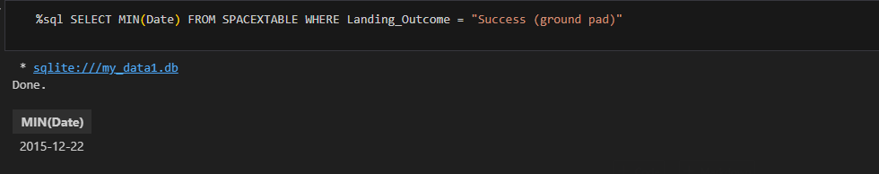
First Successful Ground Landing Date
We observed that the dates of the first successful landing outcome on ground pad was 22nd December 2015

Slide 29
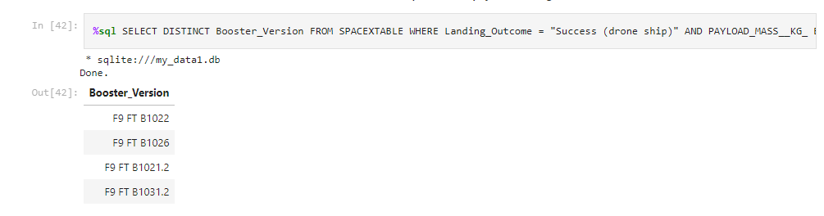
Successful Drone Ship Landing with Payload between 4000 and 6000
Using a WHERE and BETWEEN clauses in the data we determined which booster versions that successfully landed on a drone ship with a payload mass between 4000 and 6000 kg
Present your query result with a short explanation here

Slide 30
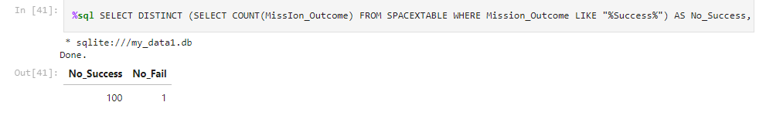
Total Number of Successful and Failure Mission Outcomes
We calculated the mission outcomes using sub-queries. As one can tell almost all missions were successful whereas only one was unsuccessful.

Slide 31
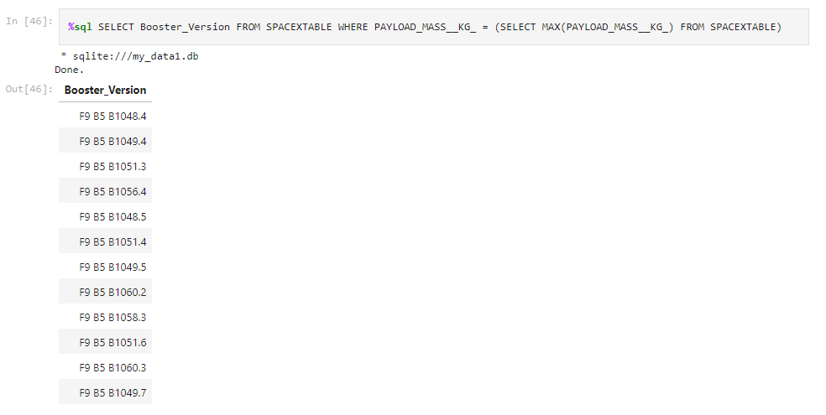
Boosters Carried Maximum Payload
Using below query and sub-query we were able to derive a list of all the booster versions carrying the MAX payload mass.

Slide 32
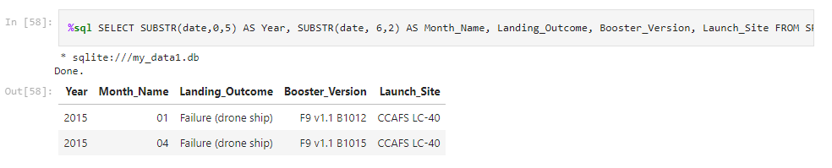
2015 Launch Records
Using a combination of the WHERE clause, LIKE, AND, and BETWEEN conditions to filter for failed landing outcomes on drone ships, their booster versions, and launch site names for the year of 2015

Slide 33
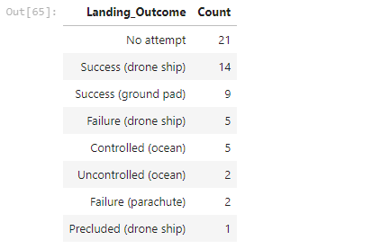
Rank Landing Outcomes Between 2010-06-04 and 2017-03-20
We selected Landing outcomes and the COUNT of landing outcomes from the data and used the WHERE clause to filter for landing outcomes BETWEEN 2010-06-04 to 2010-03-20.
We applied the GROUP BY clause to group the landing outcomes and the ORDER BY clause to order the grouped landing outcome in descending order.
%sql SELECT Landing_Outcome, COUNT(Landing_Outcome) AS Count FROM SPACEXTABLE GROUP BY Landing_Outcome HAVING DATE(date) BETWEEN "2010-06-04" AND "2017-03-20" ORDER BY Count DESC
33

Slide 34

Section 3

Slide 35
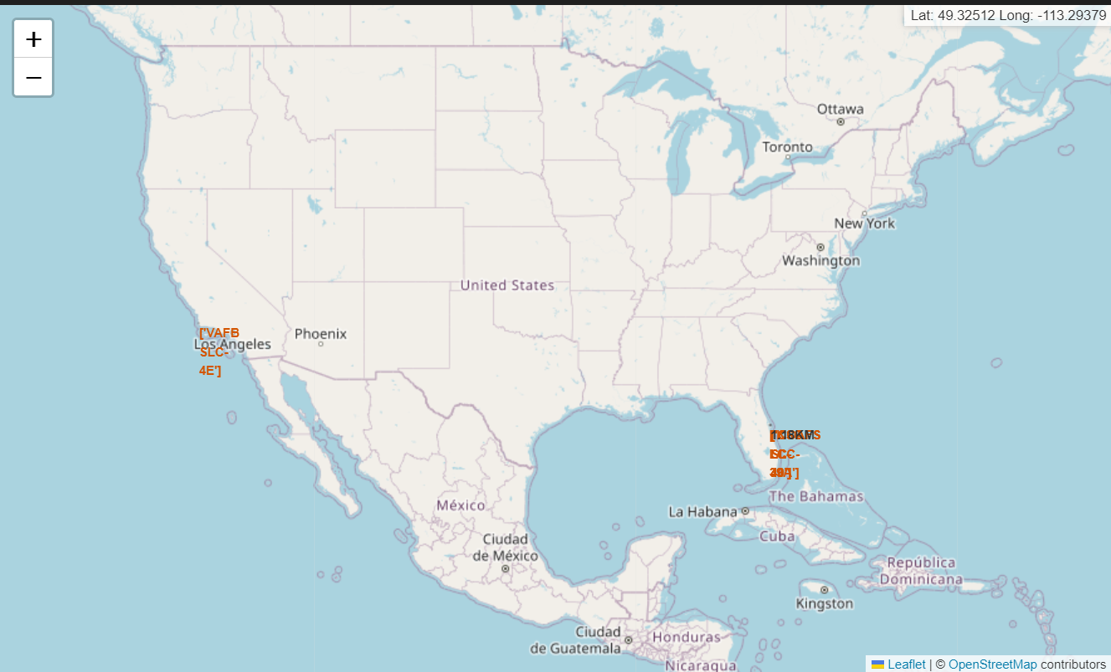
SpaceX Launch Sites
SpaceX Launch Sites are located the United Sates
All Launch Sites are close to the ocean and in states that offer a warm climate.
Launch Sites are in close proximity to the ocean due to the use of both ditching landing methods (Crash landings in the sea) and by remotely operated sea landing drones.

Slide 36
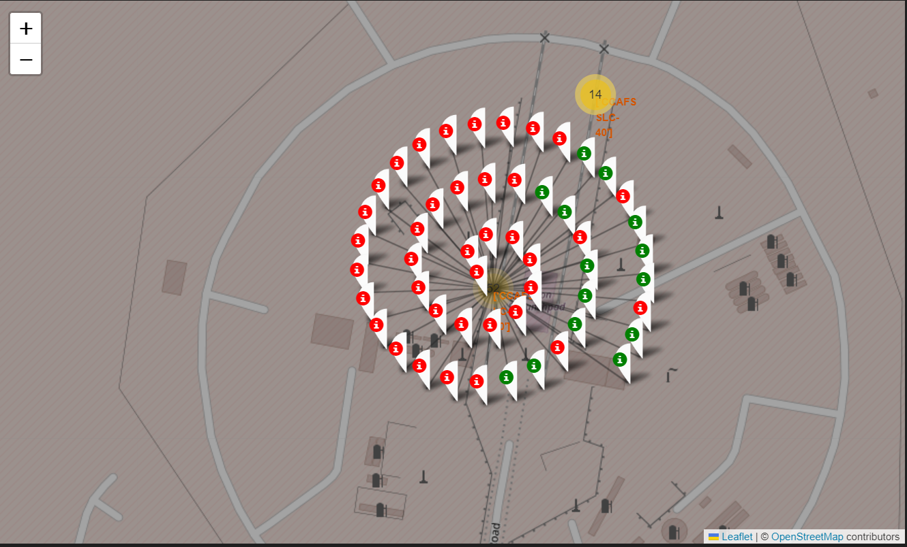
Successful & Failed Launches
Green markers represent the successful launches and the Red Marker represents the failures.

Slide 37
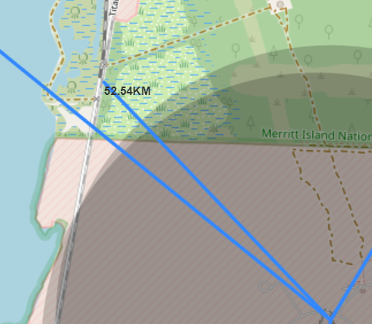
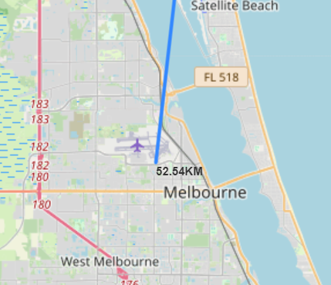
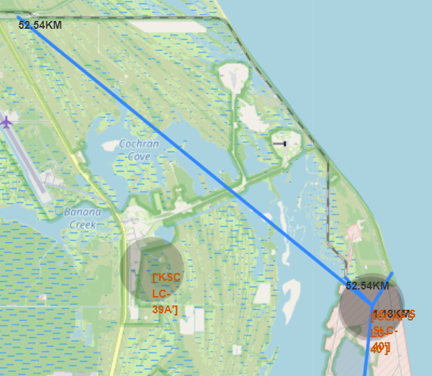
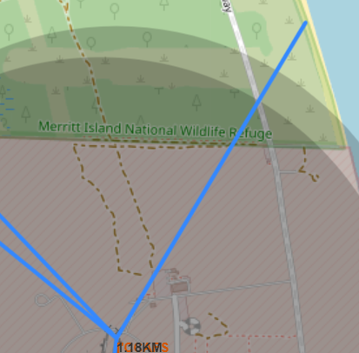
Launch Site distance to landmarks
Normally Launch Sites are in the vicinity of different landmarks such as major cities (Melbourne) and other key infrastructure objects such as waterways, rail roads and major roads as demonstrated by the maps to the right.

Slide 38

Section 4

Slide 39
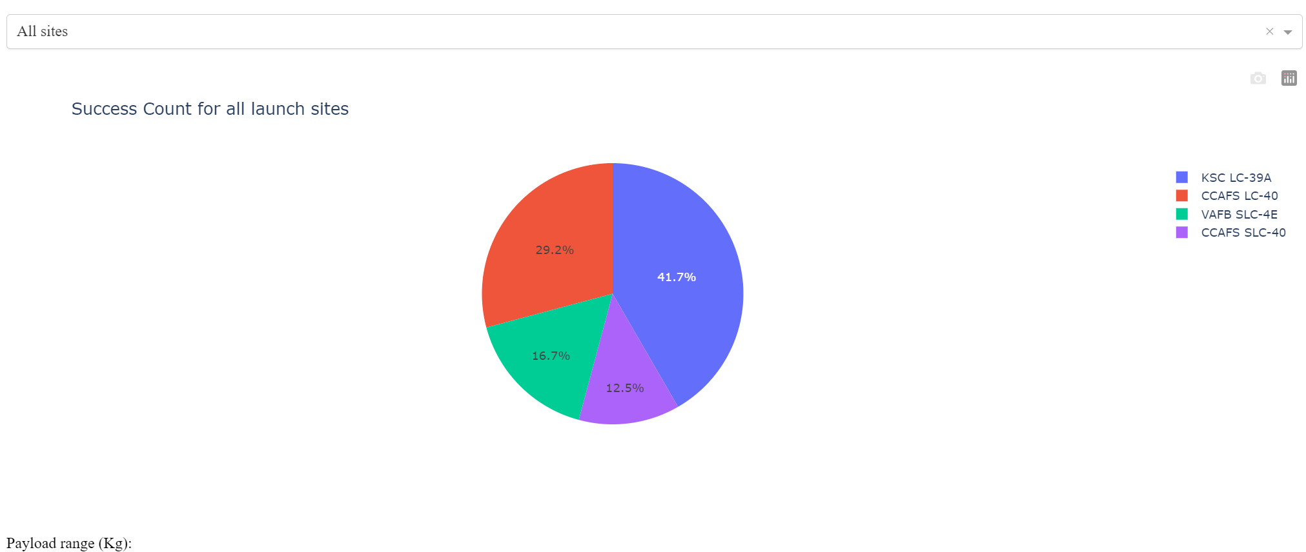
Success Percentage by Launch Site
KSC LC-39A is the site with the highest number of successful launches of all sites

Slide 40
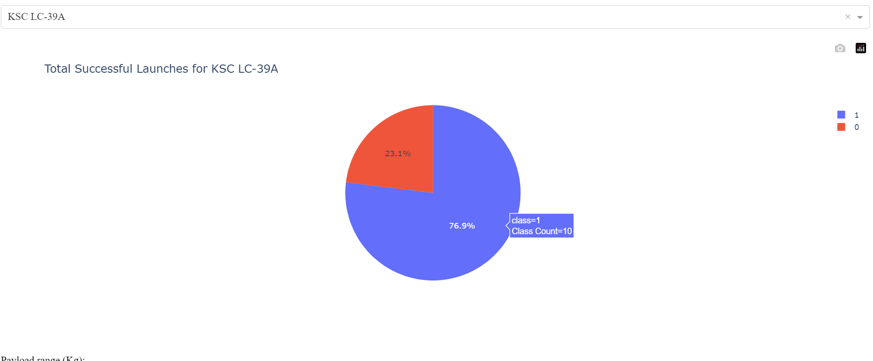
KSC LC39A – The most successful site
Launch site KSC LC-39A has a 76.9% success rate and only has a 23.1% failure rate

Slide 41
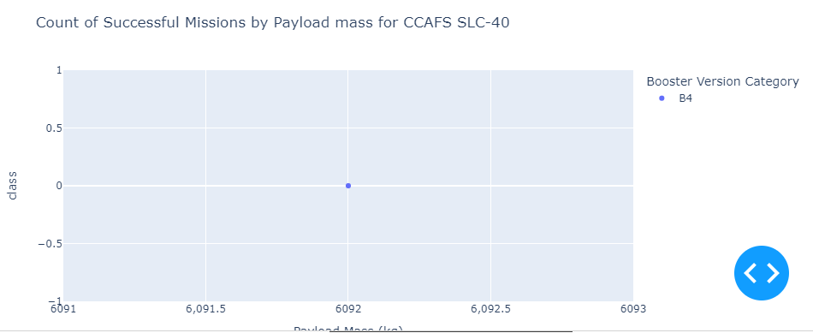
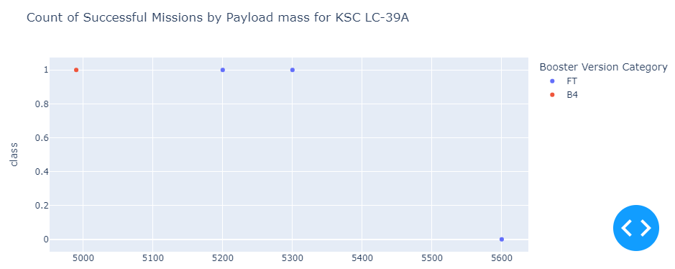
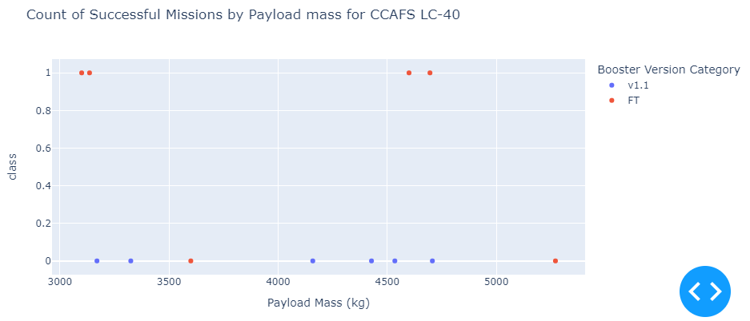
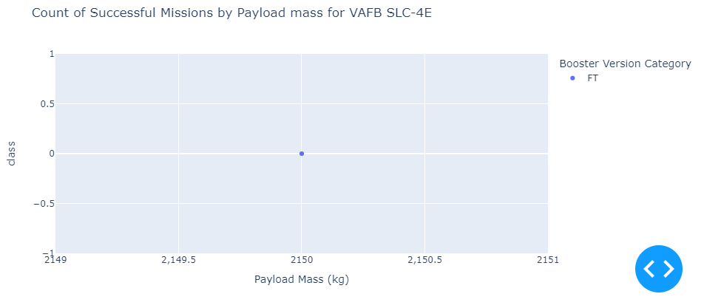
Payload mass for all sites
Data looks different for all sites. However, most of the cases include Booster Version Category FT.

Slide 42

Section 5

Slide 43
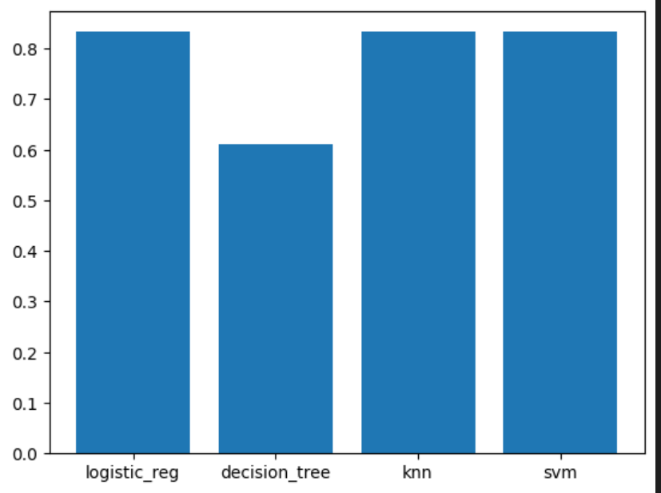
Classification Accuracy
The model, or models in this case, with the highest classification accuracy (~83%):
K-nearest neighbour, Logisitc Regression and Support Vector Maching (SVM)

Slide 44
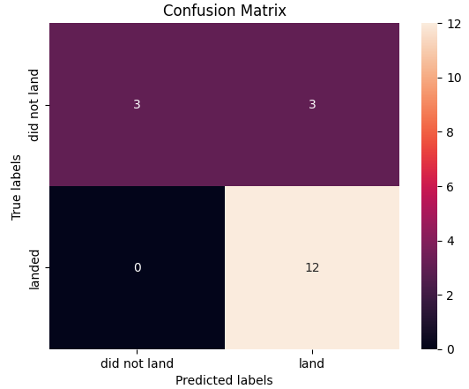
Confusion Matrix
The confusion matrix for KNN, SVM and Logistic Regression all look the same. It shows that the classifier can distinguish between the different classes (Successful, Unsuccessful landing). The major problem with our model, impacting the model’s accuracy, are the false positives.
The false positive problems could be due to overfitting the model since only 20 % of our dataset is used for test / evaluation of the model, whereas 80 % of the data is used to train the model.

Slide 45

Conclusions
Based on the findings made we conclude that:
The greater number of launches taken place at a site, the greater the success rate is at the launch site.
Launch success rate start to increase from 2013 up until 2020
Orbits ES-L1, HEO, SSO, VLEO and GEO had the largest success rate of all of the different orbit types
KSC LC-39A is the launch site the the most successful launches of any site
There are three classification models that are just as accurate in predicting wether recovery of first stage will be successful or not. These are:
KNN, SVM, and Logistic Regression

Slide 46
Include any relevant assets like Python code snippets, SQL queries, charts, Notebook outputs, or data sets that you may have created during this project
Appendix

Slide 47


